Slide 1
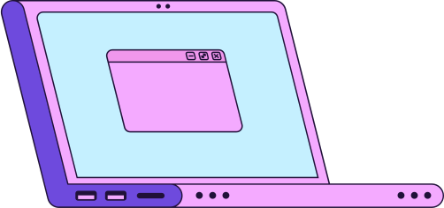
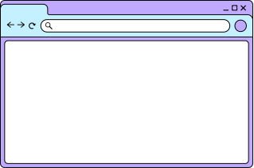
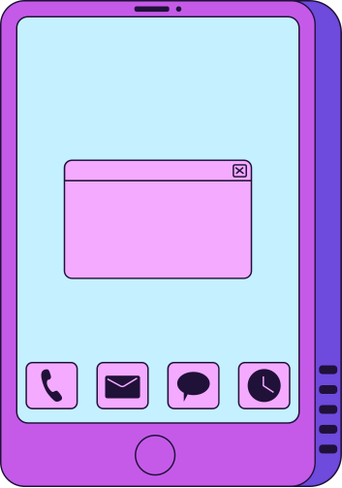
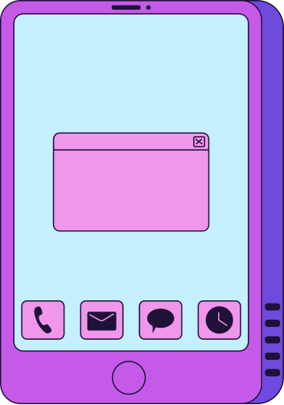
BLOCKCHAIN
GUIDE

Slide 2

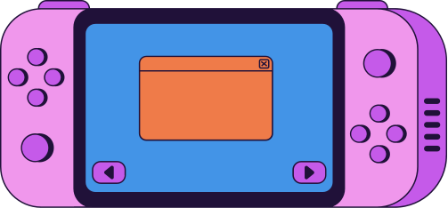
blockchain is:
A shared, immutable database that no single entity controls.
Key ideas:
Blocks = groups of transactions
Chain = blocks linked together
Nodes = computers validating data
Immutable = once written, it can’t be changed
Transparent = anyone can verify
👉 In crypto:
Wallets don’t “store money”
They store private keys that control assets on the blockchain

Slide 3

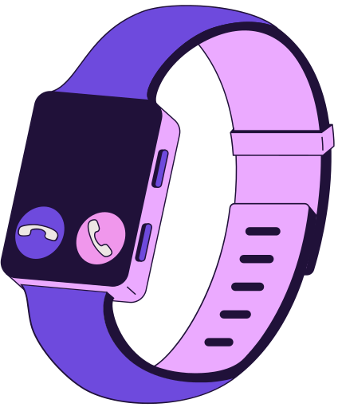
HOW BLOCKCHAIN FITS YOUR PROJECT
Your project is NOT a blockchain product first.
👉 It is:
AI + behavioral finance layer
Blockchain is:
👉 the infrastructure layer (where transactions happen)
🎯 Your architecture in simple terms:
Blockchain → executes transactions
Wallet → interface to interact with blockchain
Your AI → sits ON TOP and guides decisions

Slide 4
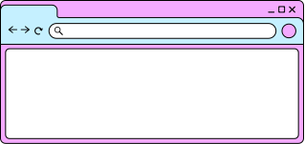
WHERE BLOCKCHAIN ADDS VALUE IN YOUR PROJECT
✅ 1. Reading user transactions (MOST IMPORTANT)
Your AI needs:
transaction history
token movements
timing
👉 This comes from blockchain

Slide 5
✅ 2. Optional: On-chain behavior analysis
You can analyze:
frequency of trades
size of trades
interaction with protocols
👉 This feeds your AI model

Slide 6
✅ 3. Optional: Proof / transparency layer
Future idea:
store “behavior scores” or achievements on-chain
verifiable learning / reputation

Slide 7
❌ What you DON’T need (for hackathon):
creating your own blockchain
complex smart contracts
token launch

Slide 8
TECHNICAL FLOW (END-TO-END)
Step 1: User connects wallet
MetaMask or similar
You get:
wallet address (public)
Step 2: Fetch blockchain data
You use APIs like:
Alchemy - Moralis - Etherscan
👉 You retrieve:
transactions - balances - activity
Step 3: Process data (your backend)
You convert raw data into:
trade frequency - buy/sell timing - patterns

Slide 9
TECHNICAL FLOW (END-TO-END)
Step 4: Detect behavior patterns
Your logic:
buying after pump → FOMO
selling after drop → panic
Step 5: Send to AI
You pass:
user action - detected pattern - context
Step 6: AI generates coaching response
Example:
“Based on your recent activity, this looks like a reactive decision rather than a planned one.”
Step 7: Show inside wallet UI
before confirming transaction
or as alert

Slide 10


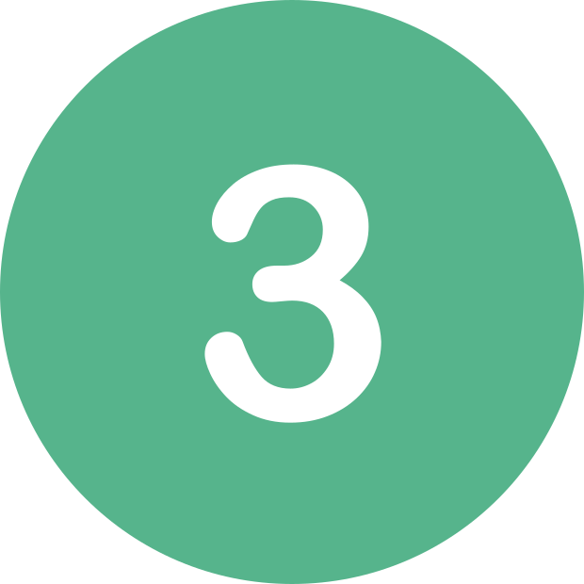



MINIMAL BLOCKCHAIN STACK
🔹 Wallet connection
MetaMask
WalletConnect
🔹 Blockchain network
Ethereum (most common)
or
Polygon (cheaper, faster)
🔹 Data providers
Alchemy API
or
Moralis
🔹 Backend
Node.js / Python
🔹 AI layer
OpenAI API
🔹 Frontend
React / simple web app

Slide 11
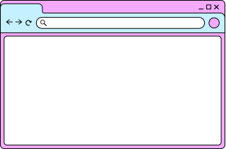
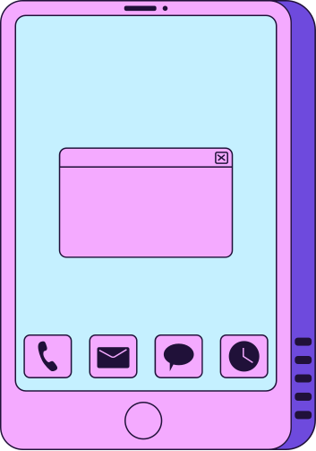
IMPORTANT DESIGN DECISION
👉 You DO NOT control funds
Your app:
reads data
suggests decisions
User:
executes transaction
💥 This is CRITICAL (legal + trust)

Slide 12
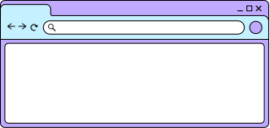

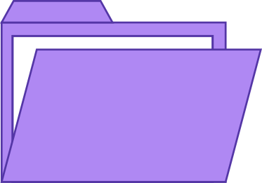
YOU´RE READY!

